Slide 1
Organizational Behavior 15th Ed
Chapter 9
Robbins and Judge
Foundations of
Group Behavior

Slide 2
Chapter 9 Learning Objectives
After studying this chapter you should be able to:
Define group and differentiate between different types of groups.
Identify the five stages of group development.
Show how role requirements change in different situations.
Demonstrate how group norms and status exert influence on an individual’s behavior.
Show how size affects group performance.
Contrast the benefits and disadvantages of cohesive groups.
Understand the implications of diversity for group effectiveness.
Contrast the strengths and weaknesses of group decision-making.
Compare the effectiveness of interacting, brainstorming, nominal, and electronic meeting groups.

Slide 3
Define group and differentiate between different types of groups
LO 1
A group is defined as two or more individuals, interacting and interdependent, who have come together to achieve particular objectives.
Groups can be either formal or informal.
Formal groups—those defined by the organization’s structure
Informal groups—alliances that are neither formally structured nor organizationally determined

Slide 4
Define group and differentiate between different types of groups
LO 1
There is no single reason why individuals join groups.
Social identity theory proposes that people have emotional reactions to the failure or success of their group because their self-esteem gets tied into the performance of the group.

Slide 5
Define group and differentiate between different types of groups
LO 1
Several characteristics make a social identity important to a person
Similarity
Distinctiveness
Status
Uncertainty reduction

Slide 6
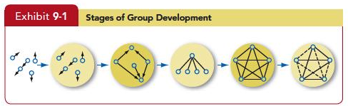
Identify the five stages of group development
LO 2

Slide 7
Identify the five stages of group development
LO 2
Group Effectiveness
Groups proceed through the stages of group development at different rates.
Those with a strong sense of purpose and strategy rapidly achieve high performance and improve over time.
Similarly, groups that begin with a positive social focus appear to achieve the “performing” stage more rapidly.

Slide 8
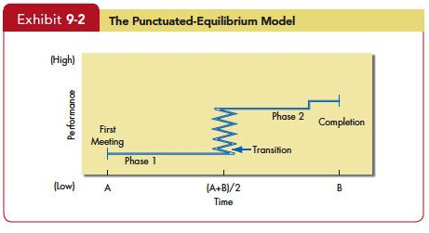
Identify the five stages of group development
LO 2

Slide 9
Show how role requirements change in different situations
LO 3
Role Properties: Roles
Role Identity
Role Perception
Role Expectations
Role Conflict

Slide 10
Demonstrate how norms and status exert influence on an individual’s behavior
LO 4
Role Properties: Norms
Performance Norms
Appearance Norms
Social Arrangement Norms
Resource Allocation Norms

Slide 11
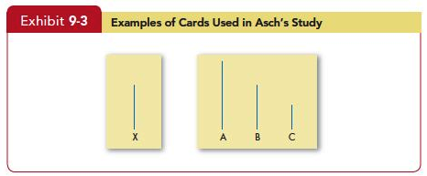
Demonstrate how norms and status exert influence on an individual’s behavior
LO 4

Slide 12
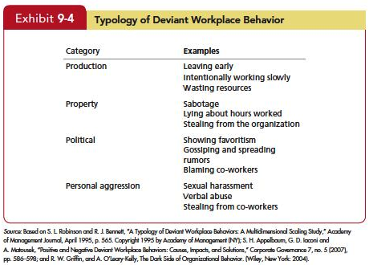
Demonstrate how norms and status exert influence on an individual’s behavior
LO 4

Slide 13
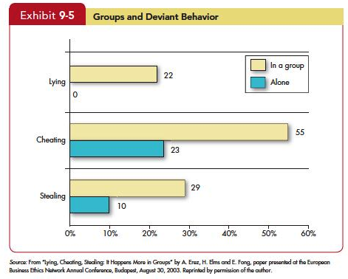
Demonstrate how norms and status exert influence on an individual’s behavior
LO 4

Slide 14
Demonstrate how norms and status exert influence on an individual’s behavior
LO 4
Group Properties: Status
Status characteristics theory – differences in status characteristics create status hierarchies within groups.
Status derived from one of three sources:
The power a person wields over others;
A person’s ability to contribute to group’s goals;
Individual’s personal characteristics.

Slide 15
Demonstrate how norms and status exert influence on an individual’s behavior
LO 4
Status and Norms
High status individuals in groups are accorded different consideration
Status and group interaction is influenced both positively and negatively
Cultural differences in status perception influences differently

Slide 16
Show how size affects group performance
LO 5
The size of a group affects the group’s overall behavior.
Social loafing- the tendency for individuals to expend less effort when working collectively than alone.
Smaller groups are faster at completing tasks than larger ones.
Large groups in problem solving do better.
Large groups are good at gaining input.
Smaller groups are better doing something with input.

Slide 17
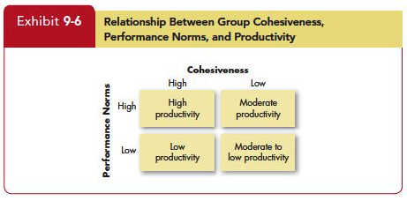
Contrast the benefits and disadvantages of cohesive groups
LO 6

Slide 18
Understand the implications of diversity for group effectiveness
LO 7
Diversity in the group’s membership
The degree to which members of the group are similar to, or different from, one another.
Research finds
More difference in values and option, the greater its conflict
Diversity can be bad for groups, unless managed effectively

Slide 19
Understand the implications of diversity for group effectiveness
LO 7
The impact of diversity on groups is mixed.
It is difficult to be in a diverse group in the short term.
Over time diversity may help them be more open-minded and creative.
Even positive effects are unlikely to be especially strong.

Slide 20
Contrast the strengths and weaknesses of group decision-making
LO 8
Strengths
More Complete knowledge
Diversity of views
Almost always out performs individuals
Increase acceptance of solutions
Weaknesses
Time
Conformity pressures

Slide 21
Contrast the strengths and weaknesses of group decision-making
LO 8
Groups can be used as an excellent decision-making processes
Source of breath and depth of input
More people to support decisions made
Group decisions
Consume time
Create conflict
Generate conformity pressures

Slide 22
Contrast the strengths and weaknesses of group decision-making
LO 8
Groupthink is related to norms
It describes situations in which group pressures for conformity deter the group from critically appraising unusual, minority, or unpopular views.
Groupshift
A change between a group’s decision and an individual decision that a member within the group would make; the shift can be toward either conservatism or greater risk but it generally is toward a more extreme version of the group’s original position.

Slide 23
Compare the effectiveness of interacting, brainstorming, nominal, and electronic meeting groups
LO 9
Interacting Groups
Most group decision-making takes place in interacting groups.
In these groups, members meet face to face and rely on both verbal and nonverbal interaction to communicate with each other.
Interacting groups often censor themselves and pressure individual members toward conformity of opinion.

Slide 24
Compare the effectiveness of interacting, brainstorming, nominal, and electronic meeting groups
LO 9
Brainstorming
Overcome pressures for conformity
The process:
The group leader states the problem clearly.
Members then “free-wheel” as many alternatives as they can.
No criticism is allowed.
One idea stimulates others, and group members are encouraged to “think the unusual.”

Slide 25
Compare the effectiveness of interacting, brainstorming, nominal, and electronic meeting groups
LO 9
The nominal group technique:
Restricts discussion or interpersonal communication during the decision-making process.
Group members are all physically present, but members operate independently.
The chief advantage of the nominal group technique is that it permits the group to meet formally but does not restrict independent thinking, as does the interacting group.

Slide 26
Compare the effectiveness of interacting, brainstorming, nominal, and electronic meeting groups
LO 9
A problem is presented, and then the following steps take place:
Members meet as a group but each member writes down his or her ideas on the problem.
After this silent period, each member presents one idea to the group.
The ideas are discussed for clarity.
Each group member rank-orders the ideas.
The idea with the highest aggregate ranking determines the final decision.

Slide 27
Compare the effectiveness of interacting, brainstorming, nominal, and electronic meeting groups
LO 9
The computer-assisted group or electronic meeting blends the nominal group technique with sophisticated computer technology.
Early evidence, suggests electronic meetings don’t achieve most of their proposed benefits.
Lead to decreased group effectiveness,
Require more time to complete tasks,
Result in reduced member satisfaction compared with face-to-face groups.

Slide 28
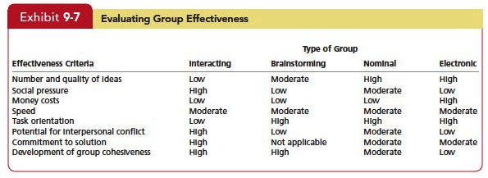
Compare the effectiveness of interacting, brainstorming, nominal, and electronic meeting groups
LO 9

Slide 29
Summary and implications for managers
Role perception and an employee’s performance evaluation are positively related.
The degree of congruence between the employee’s and the boss’s perception of the employee’s job influences the degree to which the boss will judge that employee effective.
An employee whose role perception fulfills the boss’s role expectations will receive a higher performance evaluation.

Slide 30
Summary and Implications for Managers
Norms control behavior by establishing standards of right and wrong.
The norms of a given group can help explain members’ behaviors for managers.
When norms support high output, managers can expect markedly higher individual performance than when they aim to restrict output.
Norms that support antisocial behavior increase the likelihood that individuals will engage in deviant workplace activities.

Slide 31
Summary and Implications for Managers
Status inequities create frustration and can adversely influence productivity and willingness to remain with an organization.
Incongruence is likely to reduce motivation and motivate a search for ways to bring about fairness.
Because lower-status people tend to participate less in group discussions, groups with high status differences are likely to inhibit input from lower-status members and reduce their potential.

Slide 32
Summary and Implications for Managers
The impact of size on a group’s performance depends on the type of task.
Larger groups are more effective at fact-finding activities, smaller groups at action-taking tasks.
Our knowledge of social loafing suggests that managers using larger groups should also provide measures of individual performance.

Slide 33
Summary and Implications for Managers
Cohesiveness can influence a group’s level of productivity or not, depending on the group’s performance-related norms.
Diversity appears to have a mixed impact on group performance, with some studies suggesting that diversity can help performance and others suggesting it can hurt it.

Slide 34
Summary and Implications for Managers
The group size–satisfaction relationship is what we would intuitively expect:
Larger groups are associated with lower satisfaction.
As size increases, opportunities for participation and social interaction decrease.
Having more members also prompts dissension, conflict, and the formation of subgroups.

Slide 35

All rights reserved. No part of this publication may be reproduced, stored in a retrieval system, or transmitted, in any form or by any means, electronic, mechanical, photocopying, recording, or otherwise, without the prior written permission of the publisher. Printed in the United States of America.
Copyright © 2013 Pearson Education, Inc. publishing as Prentice Hall
Notes:
All rights reserved. No part of this publication may be reproduced, stored in a retrieval system, or transmitted, in any form or by any means, electronic, mechanical, photocopying, recording, or otherwise, without the prior written permission of the publisher. Printed in the United States of America.

